Slide 1
CPU Scheduling

Slide 2
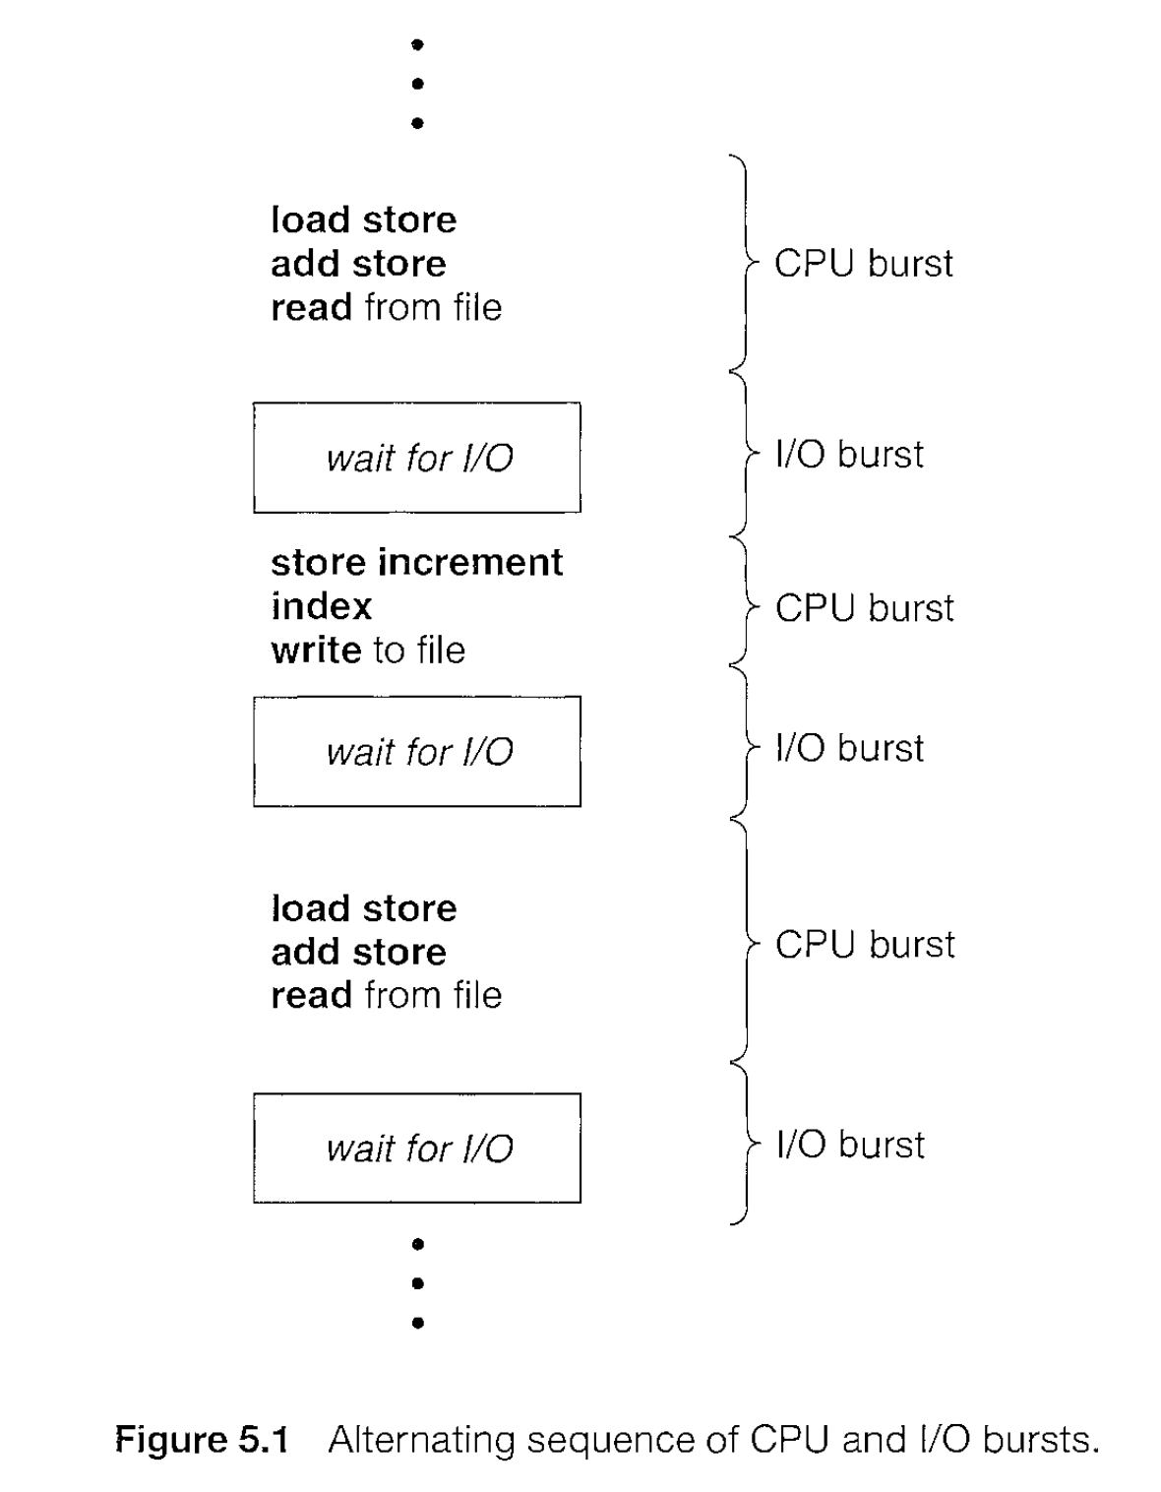
CPU-I/O Burst Cycle
The success of CPU scheduling depends on:
process execution consists of a cycle of CPU execution (CPU Burst) and I/0 wait (I/O Burst).
Processes alternate between these two states.

Slide 3
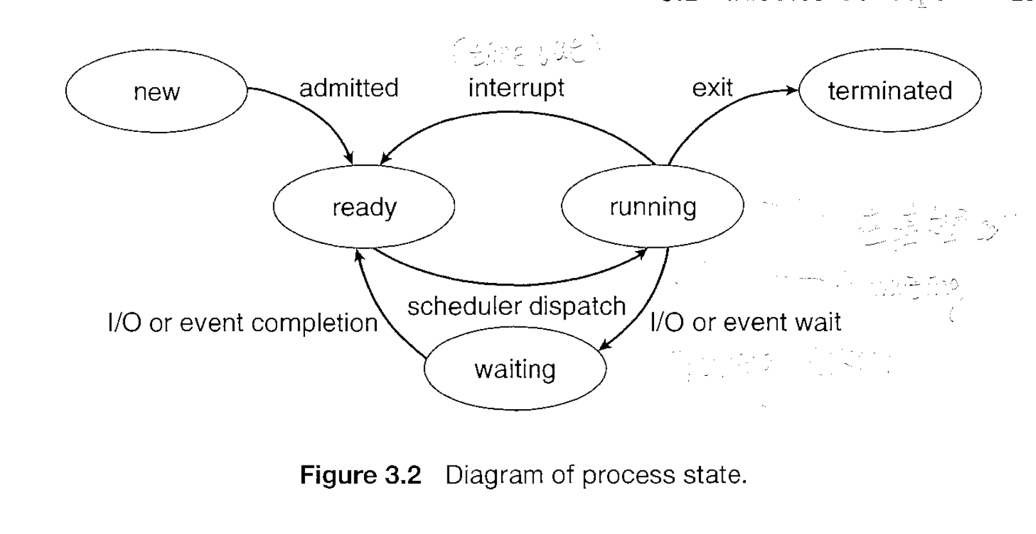
CPU Scheduler
CPU-scheduling decisions may take place under the following four circumstances:
When a process switches from the running state to the waiting state (for example, as the result of an I/0 request or an invocation of wait for the termination of one of the child processes)
When a process switches from the running state to the ready state (for example, when an interrupt occurs)
When a process switches from the waiting state to the ready state (for example, at completion of I/0)
When a process terminates
When scheduling takes place only under circumstances 1 and 4, we say that the scheduling scheme is nonpreemptive or cooperative; otherwise, it is preemptive.

Slide 4
Dispatcher
Another component involved in the CPU-scheduling function is the dispatcher.
The dispatcher is the module that gives control of the CPU to the process selected by the short-term scheduler.
This function involves the following:
  Switching context
  Switching to user mode
  Jumping to the proper location in the user program to restart that program
The dispatcher should be as fast as possible, since it is invoked during every process switch.
The time it takes for the dispatcher to stop one process and start another running is known as the dispatch latency.

Slide 5
Scheduling Criteria
CPU utilization: to keep the CPU as busy as possible.
Throughput: number of processes that are completed per time unit
Turnaround time: The interval from the time of submission of a process to the time of completion. (Turnaround = Finish time – Arrival time)
Waiting time: Waiting time is the sum of the periods spent waiting in the ready queue. (Waiting time = Turnaround time – Burst time)
Response time: time from the submission of a request until the first response is produced; the time it takes to start responding, not the time it takes to output the response.

Slide 6
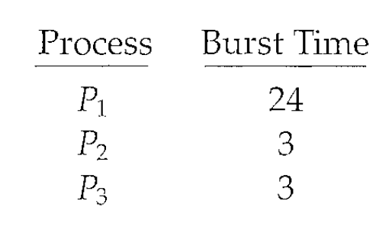
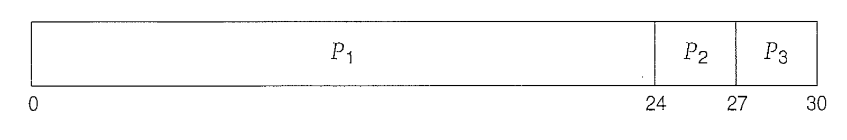
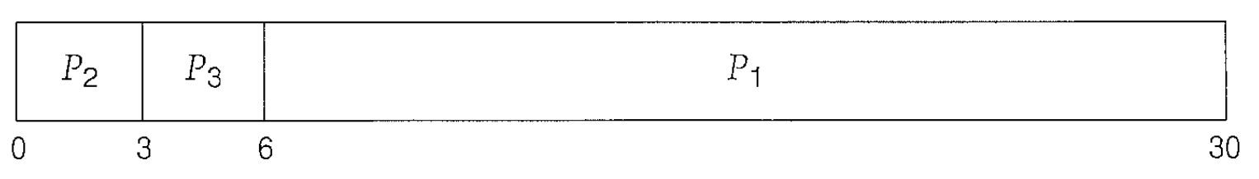
First-Come, First-Served Scheduling
Gantt Chart:
Avg wait time = ( 0 + 24 + 27 ) / 3 = 17
Gantt Chart:
Avg time = (6 + 0 + 3)/3 = 3

Slide 7
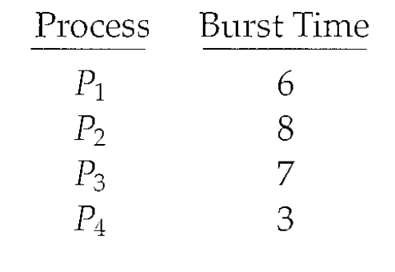
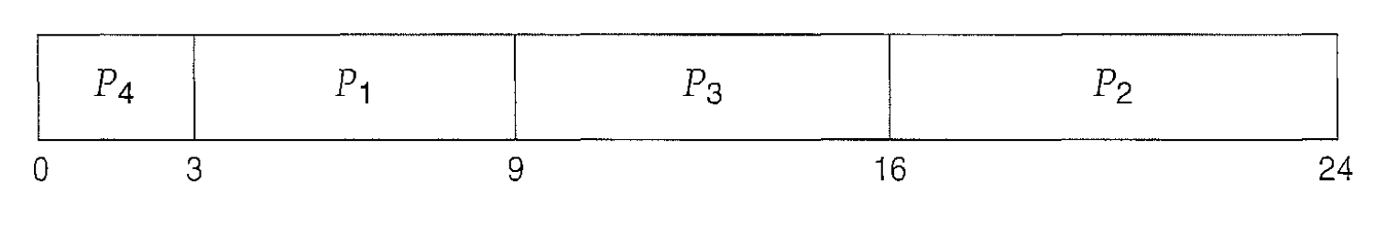
Shortest-Job-First Scheduling
Gantt chart:
Avg wait time = (3 + 16 + 9 + 0) / 4 = 7 milliseconds
If the next CPU bursts of two processes are the same, FCFS scheduling is used to break the tie.

Slide 8
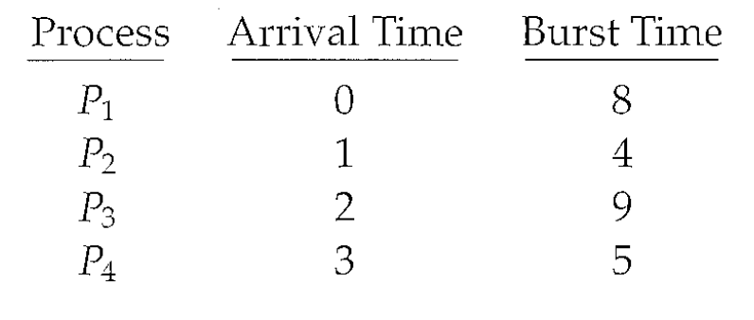
shortest-remaining-time-first scheduling
Preemptive SJF scheduling is sometimes called shortest-remaining-time-first scheduling.
A preemptive SJF algorithm will preempt the currently executing process, whereas a nonpreemptive SJF algorithm will allow the currently running process to finish its CPU burst.

Slide 9
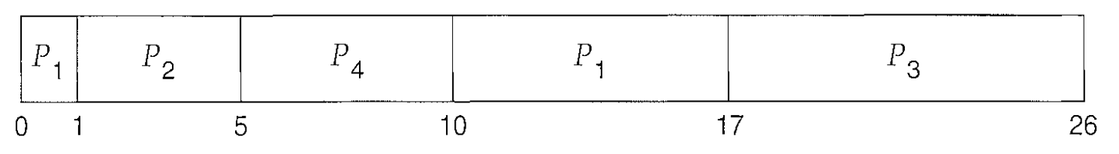
Build the SRTF schedule (Gantt chart)
Time 0 → 1: Only P1 is available → Run P1 (Remaining = 7).
Time 1: P2 arrives (burst 4). Compare:
  P1 has 7 left, P2 has 4 → Preempt P1 → Run P2.
Time 1 → 5: P2 runs completely (finishes at 5)
During that time:
At t=2, P3 arrives (burst 9).
At t=3, P4 arrives (burst 5).
So by time 5:
P1 (remaining 7), P3 (9), P4 (5).
Time 5 → 10: Pick shortest remaining (P4 = 5) → Run P4 fully. P4 finishes at 10.
Remaining: P1 (7), P3 (9).
Time 10 → 17: Next shortest is P1 (7) → Run P1, finishes at 17.
Remaining: P3 (9).
Time 17 → 26: Finally P3 runs (9), finishes at 26.

Slide 10
Calculating Waiting time
Waiting time = Turnaround time – Burst time
Where turnaround = Finish time – Arrival time.
P1 ->
Finish = 17, Arrival = 0, Burst = 8, Turnaround = 17 – 0 = 17, Waiting = 17 – 8 = 9
P2->
Finish = 5, Arrival = 1, Burst = 4, Turnaround = 5 – 1 = 4, Waiting = 4 – 4 = 0
P3->
Finish = 26 Arrival = 2 Burst = 9 Turnaround = 26 – 2 = 24 Waiting = 24 – 9 = 15
P4 ->
Finish = 10, Arrival = 3, Burst = 5, Turnaround = 10 – 3 = 7, Waiting = 7 – 5 = 2
Average Waiting Time
(9+0+15+2) / 4= 6.5 ms

Slide 11
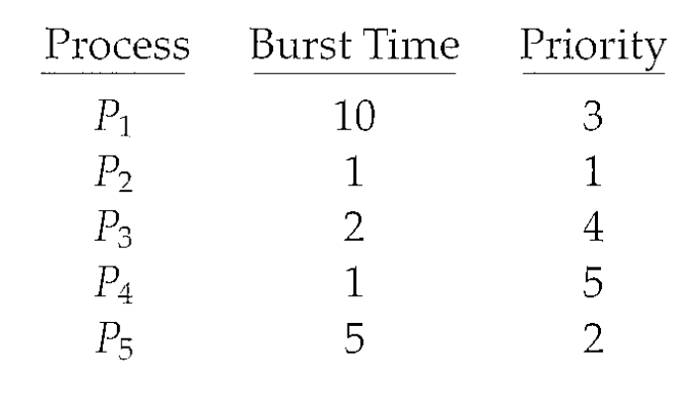
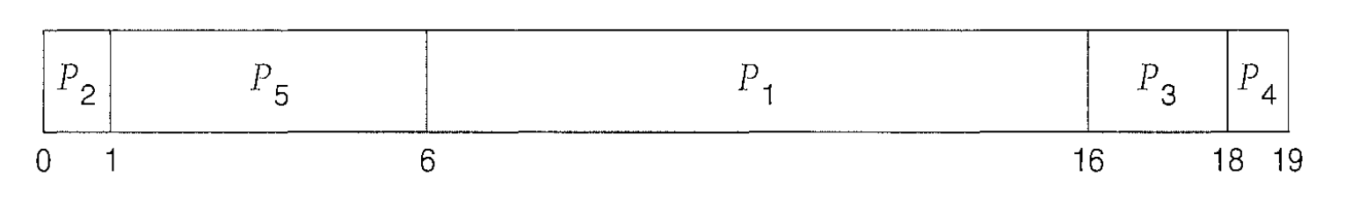
Priority Scheduling
Avg wait time: = ( 0 + 1 + 6 + 16 + 18) / 5 = 8.2 milisec
Advantages
Useful when some processes are more important than others.
Preemptive version ensures urgent jobs are handled quickly.
Disadvantages
Starvation: Low-priority processes might never get CPU.
Solution: Use Aging → Gradually increase priority of waiting processes.

Slide 12
Round Robin (RR)
Each process gets a small unit of CPU time (time quantum), usually 10-100 milliseconds. After this time has elapsed, the process is preempted and added to the end of the ready queue.
If there are n processes in the ready queue and the time quantum is q, then each process gets 1/n of the CPU time in chunks of at most q time units at once. No process waits more than (n-1)q time units.
Performance
  q large FIFO
  q small q must be large with respect to context switch, otherwise overhead is too high

Slide 13
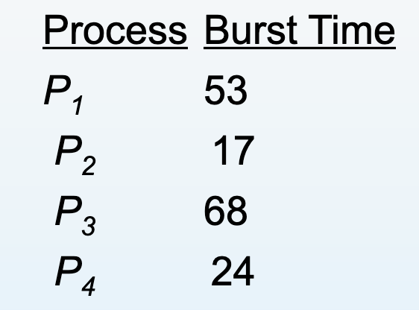
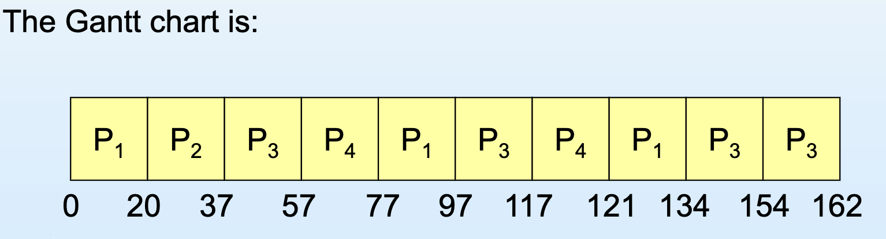
Example of RR with Time Quantum = 20

Slide 14
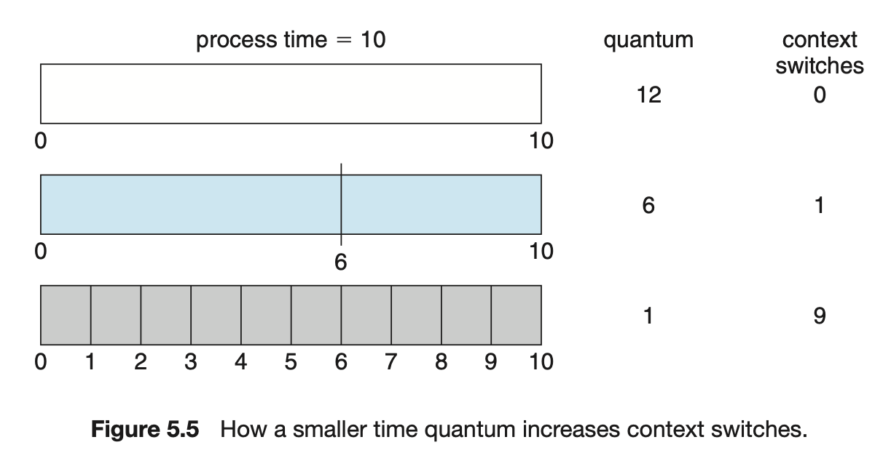

Slide 15
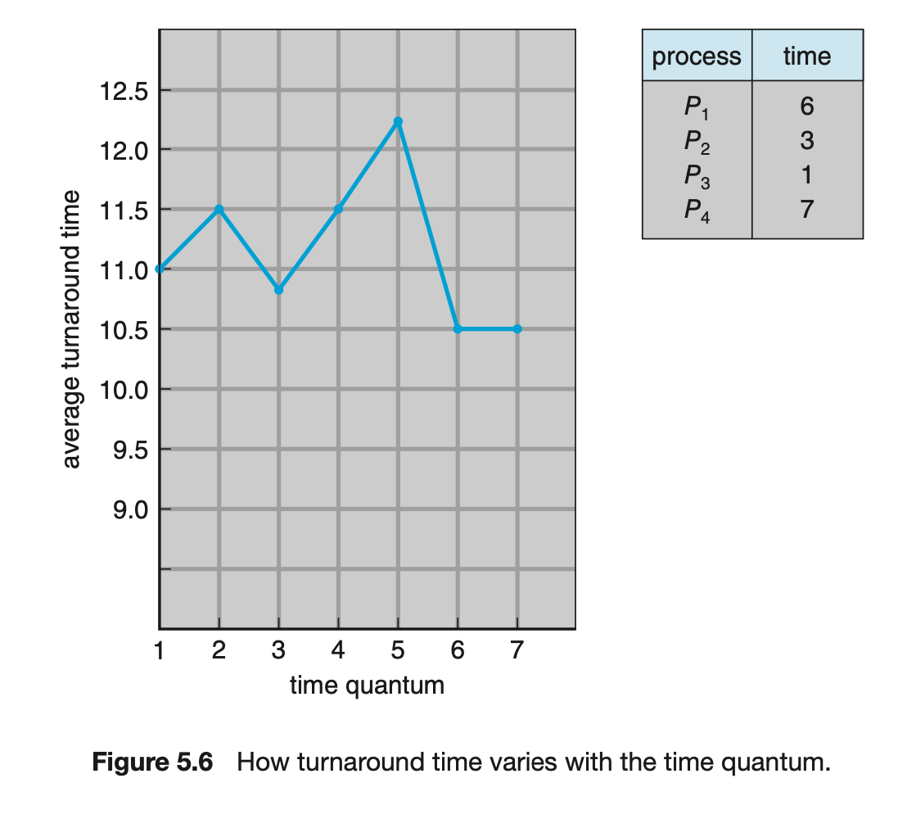
Turnaround time also depends on the size of the time quantum.
In general, the average turnaround time can be improved if most processes finish their next CPU burst in a single time quantum
given three processes of 10 time units each and a quantum of 1 time unit, the average turnaround time is 29. If the time quantum is 10, however, the average turnaround time drops to 20.
A rule of thumb is that 80 percent of the CPU bursts should be shorter than the time quantum.

Slide 16
Multilevel Queue Scheduling
Ready queue is partitioned into separate queues:
  foreground (interactive)
  background (batch)
Each queue has its own scheduling algorithm
  foreground – RR
  background – FCFS
Scheduling must be done between the queues
  Fixed priority scheduling; (i.e., serve all from foreground then from background). Possibility of starvation.
  Time slice – each queue gets a certain amount of CPU time, which it can schedule amongst its processes; i.e., 80% to foreground in RR 20% to background in FCFS

Slide 17
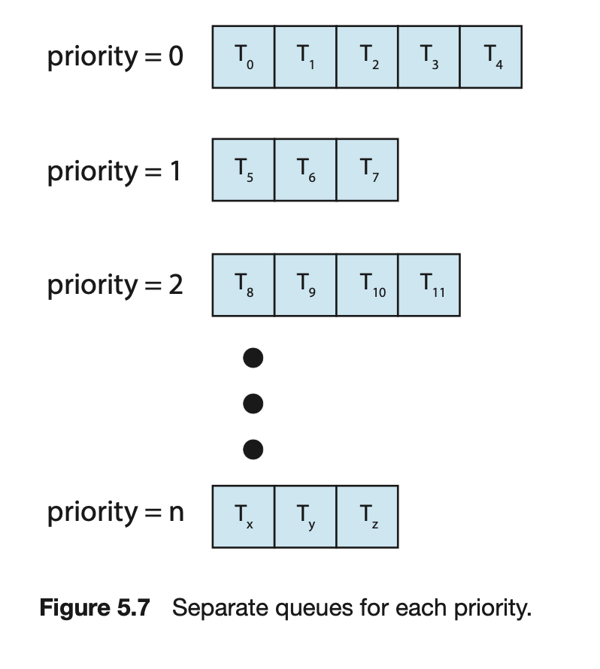
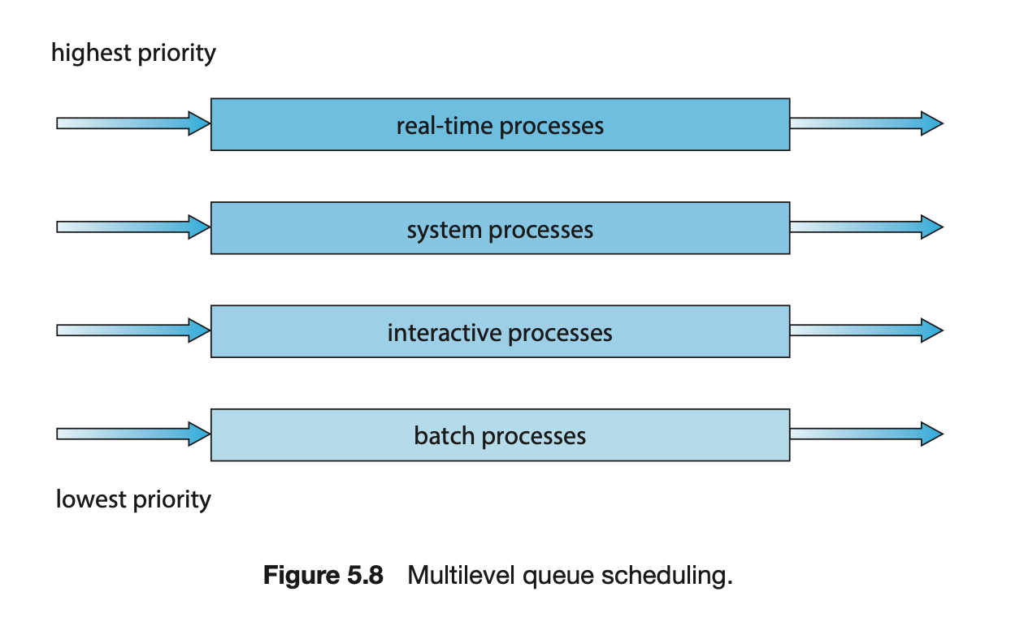
Multilevel Queue Scheduling

Slide 18
Multilevel Feedback Queue
A process can move between the various queues; aging can be implemented this way
Multilevel-feedback-queue scheduler defined by the following parameters:
  number of queues
  scheduling algorithms for each queue
  method used to determine when to upgrade a process
  method used to determine when to demote a process
  method used to determine which queue a process will enter when that process needs service

Slide 19
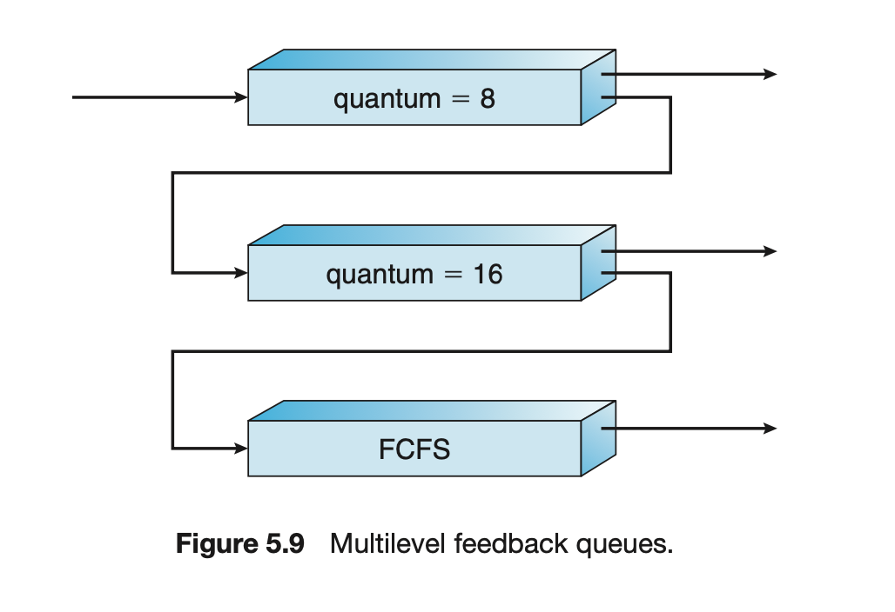
Example of Multilevel Feedback Queue
Three queues:
Q0 – RR with time quantum 8 milliseconds
Q1 – RR time quantum 16 milliseconds
Q2 – FCFS
Scheduling
- A new job enters queue Q0 which is served FCFS. When it
gains CPU, job receives 8 milliseconds. If it does not finish in 8
milliseconds, job is moved to queue Q1.
- At Q1 job is again served FCFS and receives 16 additional
milliseconds. If it still does not complete, it is preempted and
moved to queue Q2.

Slide 20
What (if any) relation holds between the following pairs of algorithm sets?
Priority and SJF
Multilevel feedback queues and FCFS
Priority and FCFS
RR and SJF

Slide 21
Priority and SJF
SJF (Shortest Job First) selects the process with the shortest next CPU burst time.
Priority scheduling selects the process with the highest priority.
If we define the priority of a process as the inverse of its next CPU burst time, then SJF becomes a special case of priority scheduling, where “priority” = 1 / (CPU burst time)
SJF is a special case (subset) of Priority scheduling.

Slide 22
Multilevel feedback queues and FCFS
Multilevel feedback queue (MLFQ) allows multiple queues, each possibly using different scheduling algorithms, and processes can move between queues based on behavior.
If we have only one queue, and that queue uses First-Come, First-Served (FCFS) scheduling, then it’s just FCFS.
FCFS is a special case (subset) of the multilevel feedback queue scheduling.

Slide 23
Priority and FCFS
FCFS schedules strictly by arrival time (the earlier process gets the CPU first).
Priority scheduling uses assigned priority values.
If all processes are given equal priority, then the scheduling order depends only on arrival time, i.e., FCFS.
FCFS is a special case (subset) of priority scheduling (when all priorities are equal).

Slide 24
RR and SJF
Round Robin (RR) uses a fixed time quantum, cycling through processes in a queue.
SJF uses predicted burst time to choose the shortest job next.
RR is time-sliced and fair, independent of job length.
SJF is length-based and non-preemptive (or preemptive if it’s SRTF).
No direct subset or inclusion relationship between RR and SJF.

Slide 25
MultiProcessor Scheduling
Asymmetric multiprocessing
- One approach to CPU scheduling in a multiprocessor system has all scheduling decisions, I/O processing, and other system activities handled by a single processor — the master server. The other processors execute only user code.
Symmetric multiprocessing (SMP)
- Scheduling proceeds by having the scheduler for each processor examine the ready queue and select a thread to run. 2 possible strategies for organizing the threads eligible to be scheduled:
1. All threads may be in a common ready queue.
2. Each processor may have its own private queue of threads.

Slide 26
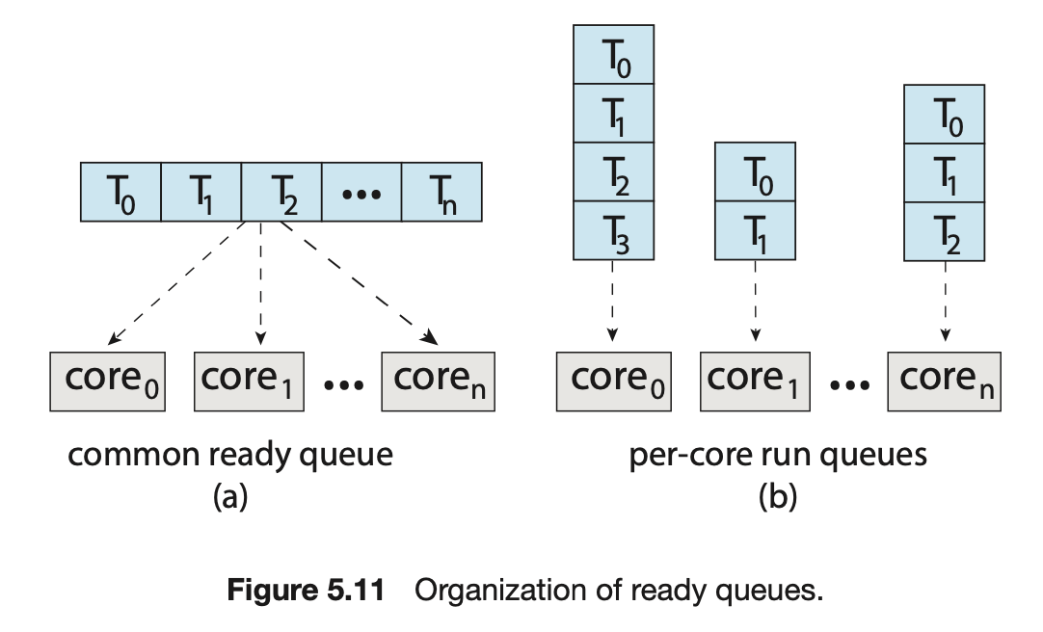
Could have a possible race condition on the shared ready queue and therefore must ensure that two separate processors do not choose to schedule the same thread and that threads are not lost from the queue
could use some form of locking to protect the common ready queue from this race condition
accessing the shared queue would likely be a performance bottleneck

Slide 27
Load Balancing
one or more processors may sit idle while other processors have high workloads, along with ready queues of threads awaiting the CPU. Load balancing attempts to keep the workload evenly distributed across all processors in an SMP system.
With push migration, a specific task periodically checks the load on each processor and—if it finds an imbalance—evenly distributes the load by moving (or pushing) threads from overloaded to idle or less-busy processors.
Pull migration occurs when an idle processor pulls a waiting task from a busy processor

Slide 28
Processor Affinity
processor affinit: a process has an affinity for the processor on which it is currently running.
Soft affinit: When an operating system has a policy of attempting to keep a process running on the same processor-but not guaranteeing that it will do so —we have a situation known as soft affinit.
Hard affinit: some systems provide system calls that support hard affinit, thereby allowing a process to specify a subset of processors which it can run.

Slide 29
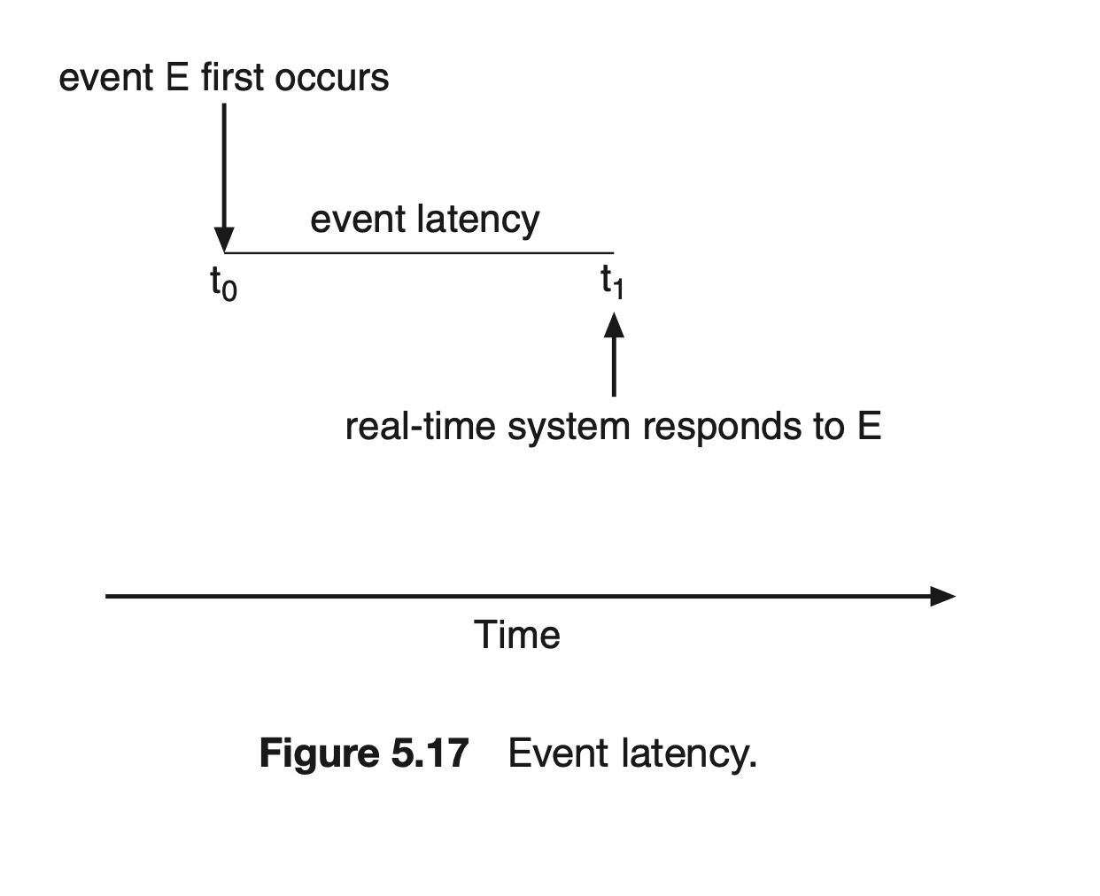
Real-Time CPU Scheduling
Minimizing Latency
When an event occurs, the system must respond to and service it as quickly as possible. We refer to event latency as the amount of time that elapses from when an event occurs to when it is serviced.

Slide 30
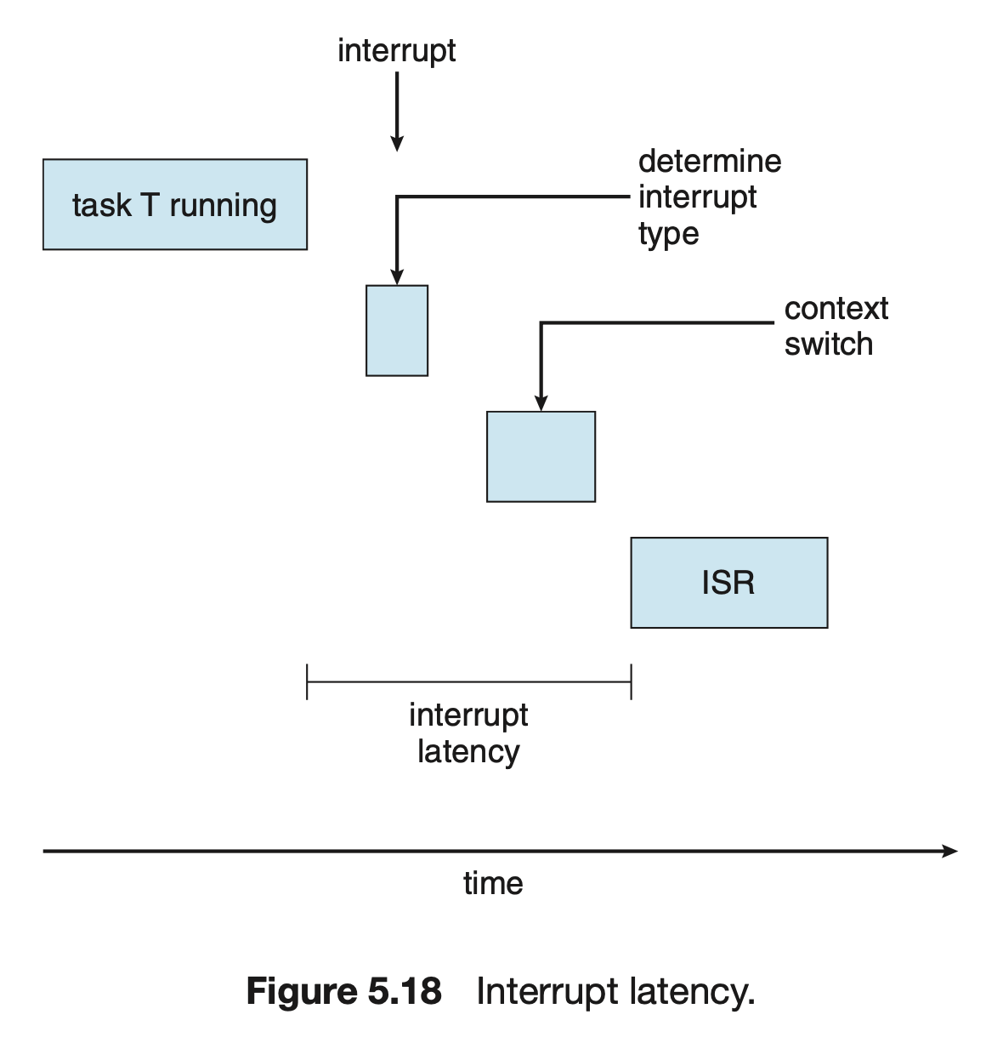
Two types of latencies affect the performance of real-time systems:
1. Interrupt latency
2. Dispatch latency

Slide 31
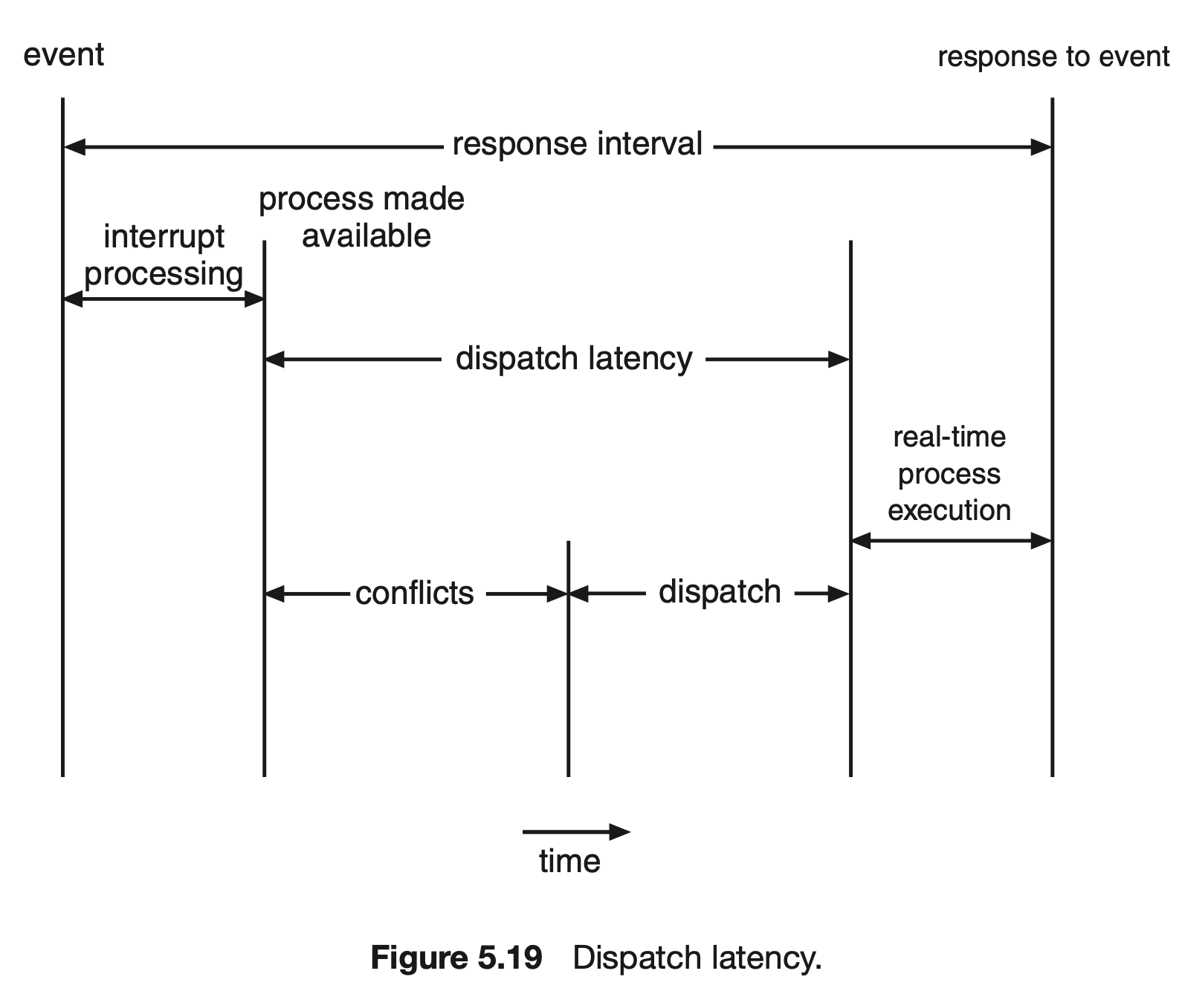
The conflict phase of dispatch latency has two components:
1. Preemption of any process running in the kernel
2. Release by low-priority processes of resources needed by a high-priority process

Slide 32
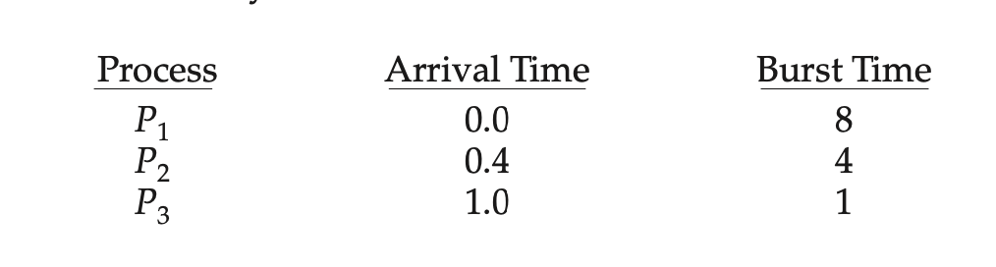
What is the average turnaround time for these processes with the FCFS scheduling algorithm?
What is the average turnaround time for these processes with the SJF scheduling algorithm?

Slide 33
FCFS
Process P1:
Arrives at 0.0
Starts immediately at 0.0
Burst time = 8
Finishes at 0.0 + 8 = 8.0
Process P2:
Arrives at 0.4, but P1 is still running
Starts at 8.0 (after P1 finishes)
Burst time = 4
Finishes at 8.0 + 4 = 12.0
Process P3:
Arrives at 1.0, but both P1 and P2 are ahead in queue
Starts at 12.0
Burst time = 1
Finishes at 12.0 + 1 = 13.0
Turnaround Time = Finish Time − Arrival Time
P1 = 8 - 0 = 8
P2 = 12 - 0.4 =11.6
P3 = 13 - 1 = 12
Average Turnaround = (8.0+11.6+12.0) / 3 = 10.533

Slide 34
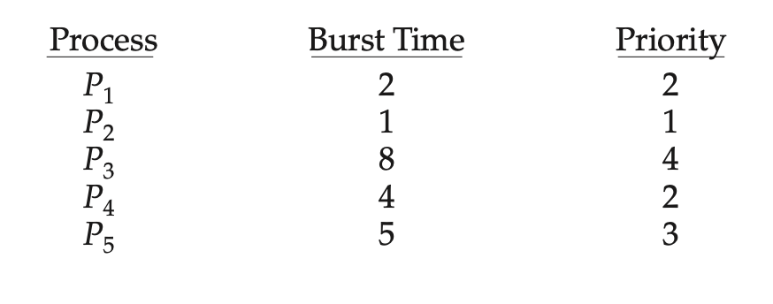
RR (quantum = 2)

Slide 35
RR (quantum = 2)
Ready queue initially: P1, P2, P3, P4, P5. Quantum = 2; run in cyclic order until completion.
P1 [0–2] (completes)
P2 [2–3] (completes)
P3 [3–5] (rem 6)
P4 [5–7] (rem 2)
P5 [7–9] (rem 3)
P3 [9–11] (rem 4)
P4 [11–13] (completes)
P5 [13–15] (rem 1)
P3 [15–17] (rem 2)
P5 [17–18] (completes)
P3 [18–20] (completes)

Slide 36
SJF (nonpreemptive shortest-job-first)
Order by burst length:
P2(1); P1(2); P4(4); P5(5); P3(8)
Intervals:
P2 [0–1],
P1 [1–3],
P4 [3–7],
P5 [7–12],
P3 [12–20]

